Slide 1

Deep Neural Network Module # 6: CNN
DNN Team
BITS Pilani WILP

Slide 2
The instructor is gratefully acknowledging the authors who made their course materials freely available online.
This deck is prepared by Seetha Parameswaran.
Deep Neural Network

Slide 3










Table of Contents
Computer Vision Tasks
Image Basics and Image Classification Challenges
Introduction to Convolutional Networks
CNN Components
CNN Architecture Design
Popular CNN Architectures
Transfer Learning
CNN Applications
Implementation Considerations
Summary
1
2
3
4
5
6
7
8
9
10
Deep Neural Network

Slide 4


Table of Contents
Computer Vision Tasks
Image Basics and Image Classification Challenges
Introduction to Convolutional Networks
CNN Components
CNN Architecture Design
Popular CNN Architectures
Transfer Learning
CNN Applications
Implementation Considerations
Summary
1
2
3
4
5
6
7
8
9
10
Deep Neural Network

Slide 5
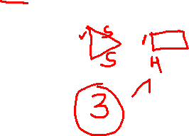
Design Patterns for Deep Networks
How do we design effective deep CNN architectures?
Key Design Patterns (Common to successful architectures):
Spatial reduction + Channel expansion Repetitive building blocks Skip/residual connections
Bottleneck designs
Multi-scale feature extraction
1
2
3
4
5
Goal: Balance between:
Model capacity (expressiveness) Computational efficiency Memory requirements
Training stability
Deep Neural Network

Slide 6
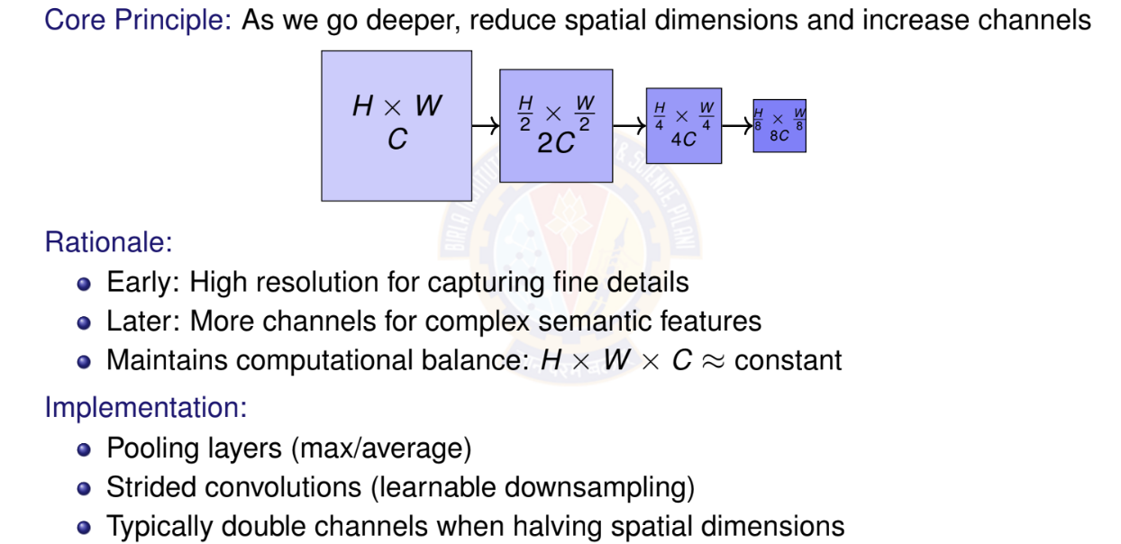
Pattern 1: Spatial Reduction + Channel Expansion
Deep Neural Network
99 / 153

Slide 7
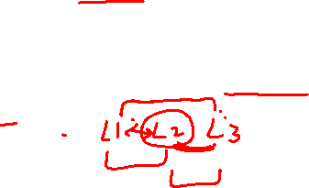
Pattern 2: Repetitive Building Blocks
Instead of arbitrary layers, use repeated modular blocks
VGG Block:
Multiple 3×3 convs + pooling
VGG Block
ResNet Block:
Convs + skip connection
ResNet Block
Conv 3×3
Conv | 3×3
Conv | 3×3
Conv 3×3
MaxPool
+
Benefits: Modularity, easier to scale, proven designs
Deep Neural Network
100 / 153

Slide 8


Pattern 3: Skip/Residual Connections
Problem: Deep networks suffer from vanishing gradients Solution: Add identity shortcuts (skip connections)
F (x)
x Weight Weight +
y
identity
y = F (x) + x
Key Benefits:
Easier gradient flow during backpropagation Network can learn identity mapping if needed
Enables training of very deep networks (100+ layers)
Used in ResNet, DenseNet, U-Net
Deep Neural Network
101 / 153

Slide 9

Pattern 4: Bottleneck Designs
Goal: Reduce computational cost without sacrificing performance
Strategy: Use 1×1 convolutions to reduce dimensions before expensive operations 8× parameter reduction! Used in ResNet-50/101/152, Inception, MobileNet
Standard: Bottleneck:
256 ch
256 ch
1×1 Conv
Conv 3×3
590K params
64 ch
256 ch
Conv 3×3
70K params
64 ch
1×1 Conv
256 ch
Deep Neural Network
102 / 153

Slide 10

Pattern 5: Multi-Scale Feature Extraction
Idea: Process input at multiple scales simultaneously Inception Module Example:
Concatenate
1×1
3×3
5×5
Pool
Input
Benefits:
Capture features at different scales More robust to object size variations
Network decides which scale is important
Deep Neural Network
103 / 153

Slide 11
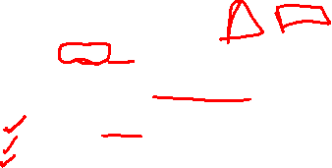
How to Choose Architecture Depth
Key Considerations:
Task complexity
⁾ Simple: MNIST 5-10 layers sufficient
⁾ Complex: ImageNet 50-152 layers
⁾ Very complex: Medical imaging 100+ layers
Dataset size
⁾ Small dataset (< 10K): Shallow network (avoid overfitting)
⁾ Medium (10K-100K): Moderate depth (20-50 layers)
⁾ Large (> 1M): Very deep (50-200 layers)
Computational budget
⁾ Mobile/edge: MobileNet, EfficientNet (10-20 layers)
⁾ Desktop/server: ResNet-50, VGG-16 (16-50 layers)
⁾ Data center: ResNet-152, EfficientNet-B7 (100+ layers)
1
2
3
Start shallow, add depth if underfitting and you have enough data
Deep Neural Network

Slide 12
Architecture Depth: Practical Guidelines
Empirical observations:
Network | Layers | Params | Use Case
LeNet-5 | 5 | 60K | MNIST, simple tasks
AlexNet | 8 | 60M | ImageNet (2012)
VGG-16 | 16 | 138M | High accuracy, features
ResNet-50 | 50 | 25M | General purpose
ResNet-152 | 152 | 60M | State-of-art accuracy
EfficientNet-B0 | 18 | 5M | Mobile, efficient
Trends:
Modern architectures: 50-200 layers with skip connections Efficient architectures: 10-30 layers with smart design Depth alone is not enough: Need proper training techniques
Warning: Very deep networks require: Batch normalization
Deep Neural Network

Slide 13
Trade-offs: Depth vs. Width
Depth: Number of layers (vertical stacking)
Width: Number of channels per layer (horizontal expansion)
Aspect | Deeper (More Layers) | Wider (More Channels)
Feature complexity | Higher | Moderate
Receptive field | Larger | Same
Parameters | Sub-linear growth | Quadratic growth
Training difficulty | Harder (vanishing grad) | Easier
Overfitting risk | Lower (if regularized) | Higher
Inference speed | Slower (sequential) | Faster (parallel)
Example:
ResNet-50: Deep (50 layers), moderate width (256-2048 channels) Wide ResNet: Fewer layers (16-28), very wide (up to 10× channels)
Current consensus: Depth + Width both matter; optimal ratio depends on task
Deep Neural Network

Slide 14
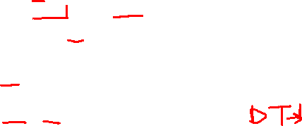
Depth vs. Width: Practical Recommendations
When to go deeper:
⁾ Large, diverse datasets (ImageNet, COCO)
⁾ Complex tasks requiring hierarchical features
⁾ When you can use skip connections
⁾ Sufficient computational resources
When to go wider:
⁾ Smaller, more homogeneous datasets
⁾ Need faster training/inference
⁾ Limited to shallow networks (no residual connections)
⁾ Ensemble-like behavior (different filters learn different patterns)
Hybrid approach (EfficientNet):
⁾ Scale depth, width, AND resolution together
⁾ Use compound scaling: depth^{d} × width^{w} × resolution^{r} = 2
⁾ Achieves better accuracy-efficiency trade-off
Deep Neural Network

Slide 15
Design Decision Framework
1
Start with baseline
⁾ Use proven architecture (ResNet, EfficientNet)
⁾ Transfer learning if possible
Estimate requirements
⁾ Dataset size depth constraint
⁾ Computational budget width/depth trade-off
⁾ Input resolution receptive field needs
Iterate systematically
⁾ Underfitting? Add depth or width
⁾ Overfitting? Regularize (dropout, data aug) before reducing capacity
⁾ Too slow? Reduce width or use efficient blocks
Apply design patterns
⁾ Always: Spatial reduction + channel expansion
⁾ Deep networks: Skip connections mandatory
⁾ Tight budget: Bottleneck designs
2
3
4
Deep Neural Network

Slide 16

Table of Contents
Computer Vision Tasks
Image Basics and Image Classification Challenges
Introduction to Convolutional Networks
CNN Components
CNN Architecture Design
Popular CNN Architectures
Transfer Learning
CNN Applications
Implementation Considerations
Summary
1
2
3
4
5
6
7
8
9
10
Deep Neural Network

Slide 17
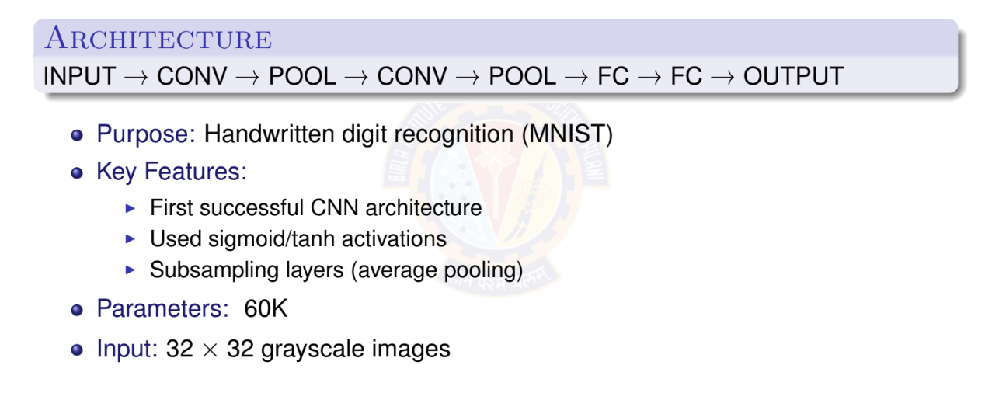
LeNet-5 (1998)
Deep Neural Network

Slide 18
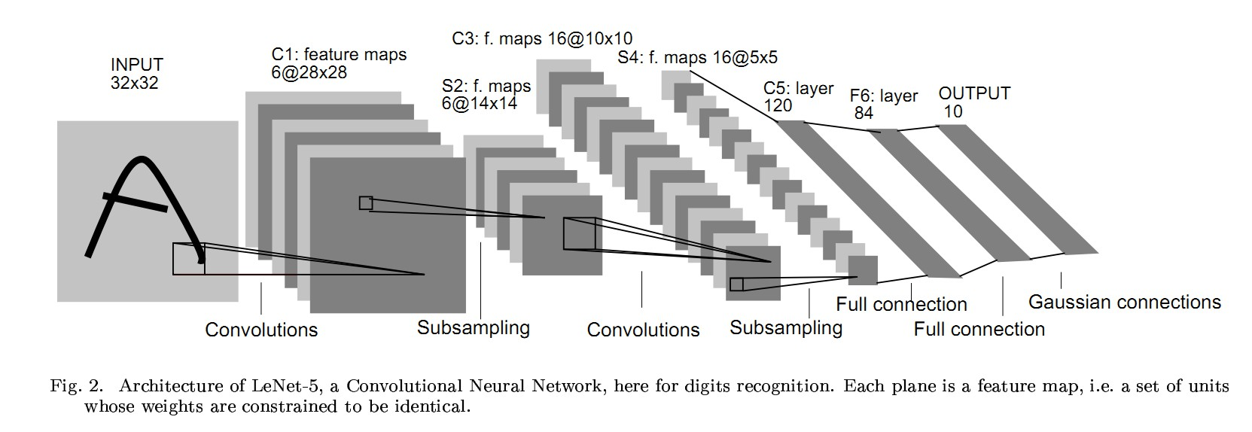
LeNet-5 Architecture
Deep Neural Network

Slide 19
AlexNet (2012)
Key Innovations
Used ReLU activations (instead of sigmoid/tanh)
Dropout for regularization Data augmentation
GPU acceleration
Local Response Normalization (LRN)
Architecture: 8 layers (5 CONV + 3 FC) Parameters: 60M
Input: 224 × 224 × 3
Achievement: Won ImageNet 2012 (Top-5 error: 15.3 Impact: Sparked the deep learning revolution
Deep Neural Network

Slide 20
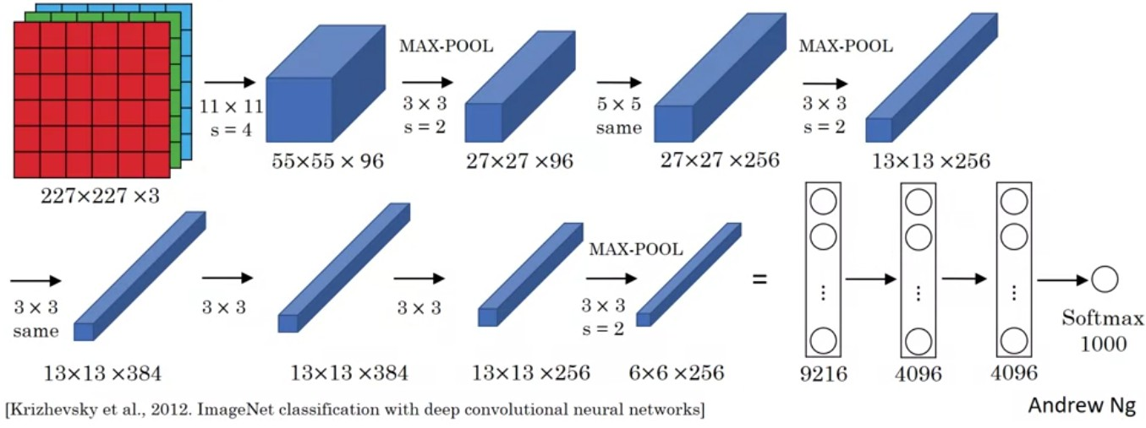
AlexNet Architecture
Deep Neural Network

Slide 21
VGGNet (2014)
Key Principles
Very small (3×3) convolution filters
Deep networks (16-19 layers) Simple and uniform architecture
Only 3×3 conv and 2×2 pooling throughout
VGG-16 Configuration:
13 CONV layers + 3 FC layers
All CONV layers: 3×3 filters, stride 1, pad 1 All pooling: 2×2 max pool, stride 2
Advantages:
Simple, homogeneous architecture
Two 3×3 conv ≈ one 5×5 conv (fewer parameters) More non-linearities
Deep Neural Network

Slide 22
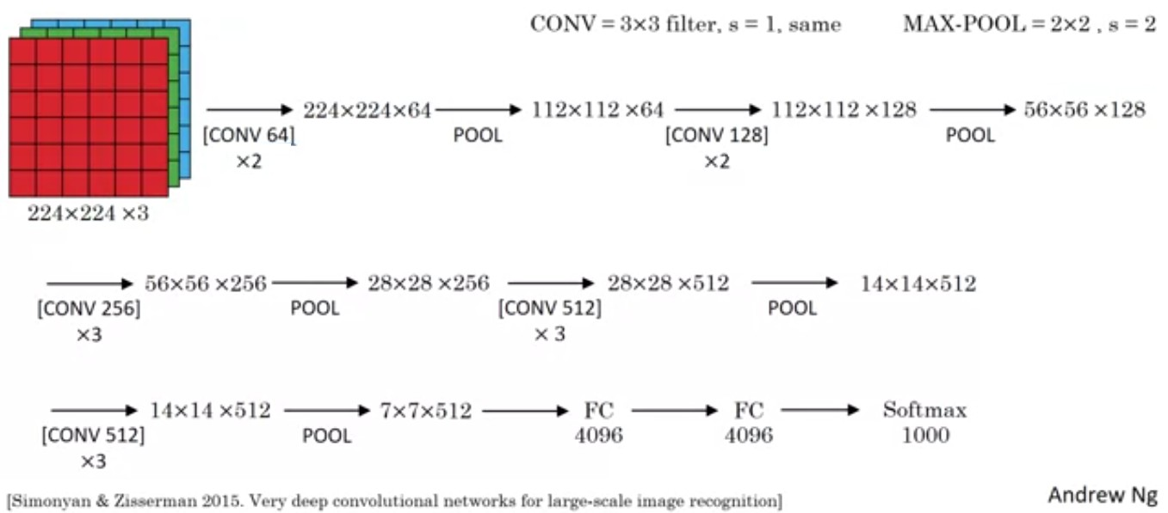
VGGNet Architecture
Deep Neural Network

Slide 23
Network in Network (NiN) - 2013
Core Innovation
Replace linear convolution filters with ”micro neural networks” (MLPconv layers) to increase model discriminability with fewer parameters.
Key Ideas:
MLPconv: Mini multi-layer perceptron instead of linear filter
1×1 Convolutions: Add non-linearity and cross-channel pooling Global Average Pooling: Replace fully connected layers Reduces overfitting: Fewer parameters than traditional CNNs
Impact:
Introduced 1×1 convolutions to deep learning Inspired Inception and other modern architectures Global average pooling became standard practice
Deep Neural Network

Slide 24
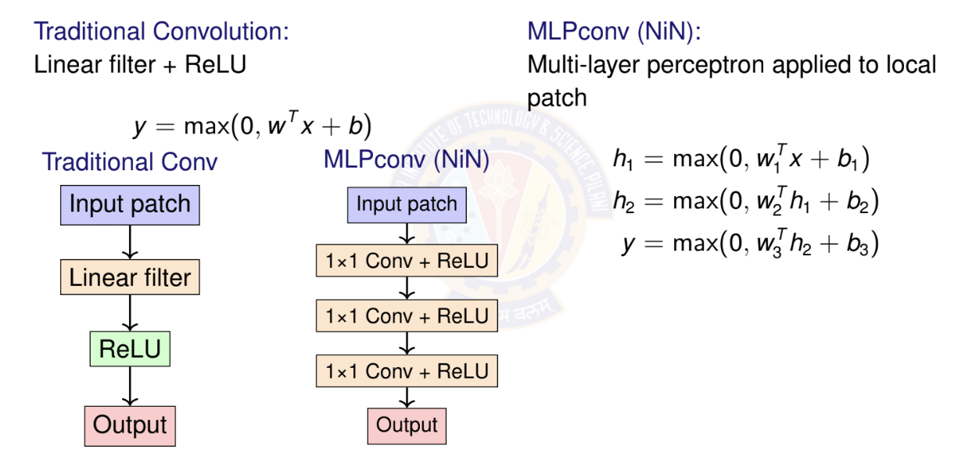
NiN: MLPconv Layer
Deep Neural Network

Slide 25
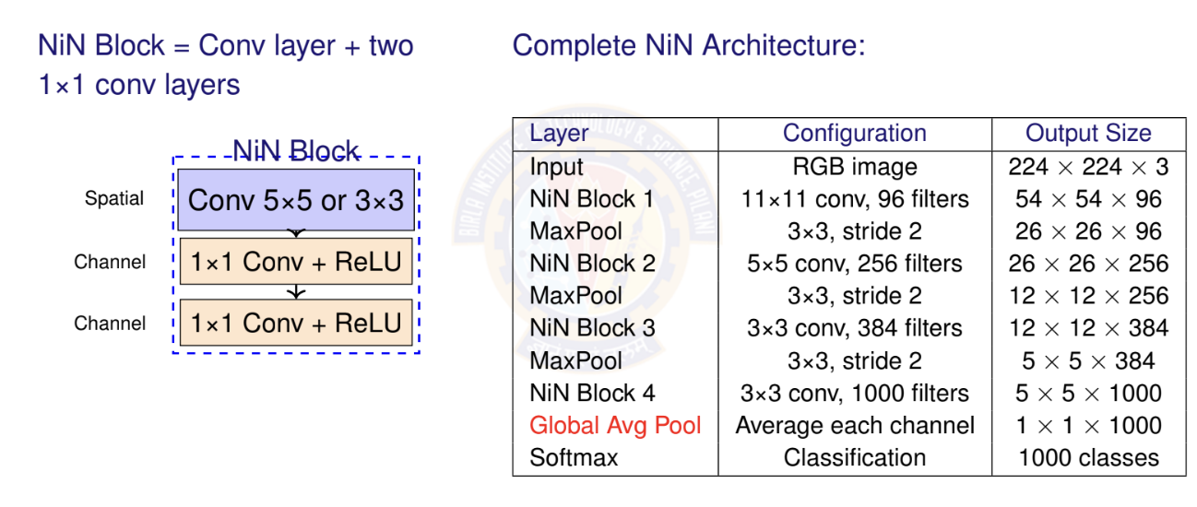
NiN: Architecture Structure
Deep Neural Network

Slide 26
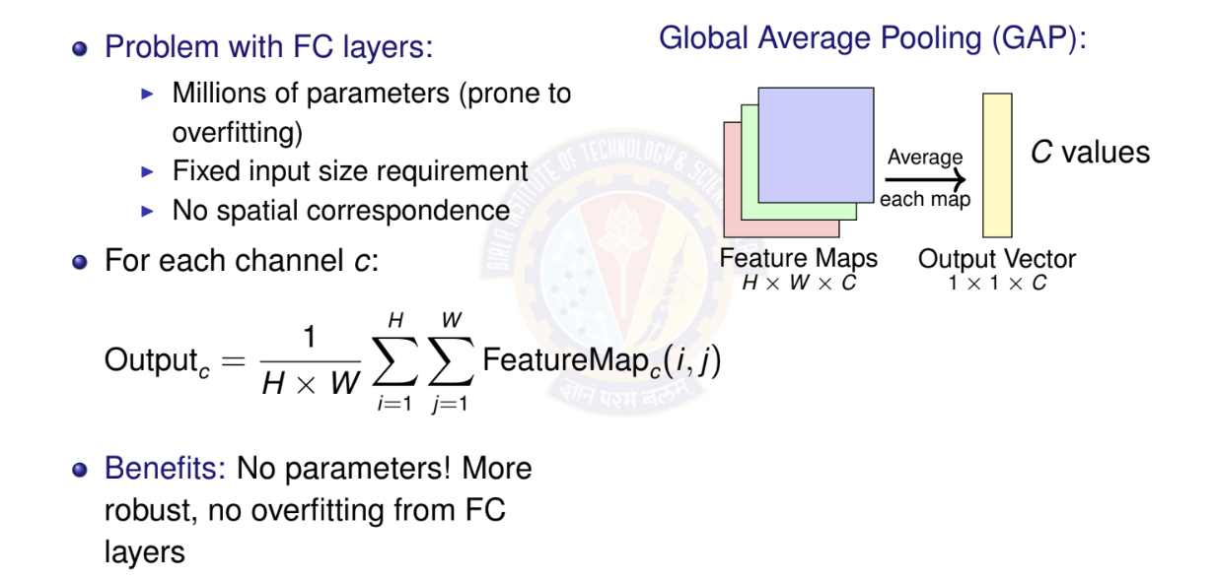
NiN: Global Average Pooling
Deep Neural Network

Slide 27
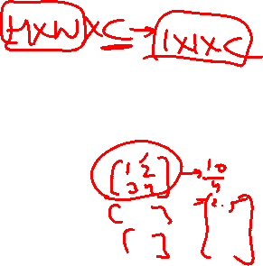
NiN: Key Takeaways
Contributions
1×1 Convolutions: First to extensively use for adding non-linearity MLPconv: More expressive local models
Global Average Pooling: Eliminates FC layers, reduces overfitting Fewer Parameters: Despite deeper, fewer params than AlexNet
1
2
3
4
Impact on Later Architectures:
GoogLeNet: Adopted 1×1 convs in Inception modules ResNet: Uses 1×1 convs in bottleneck blocks MobileNet: Core building block is 1×1 convolutions
Modern CNNs: GAP is now standard instead of FC layers
Deep Neural Network

Slide 28
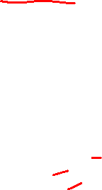
GoogLeNet/Inception (2014) - Overview
Key Innovation: Inception Module
Use multiple filter sizes in parallel to capture features at different scales, then concatenate results.
Motivation:
Objects appear at different scales in images
Hard to choose optimal filter size (1×1? 3×3? 5×5?) Solution: Use all of them!
Key Achievements:
Winner: ImageNet ILSVRC 2014 (6.67% top-5 error) Depth: 22 layers (very deep for 2014)
Parameters: 5M (12× fewer than AlexNet!) Architecture: Stack of inception modules
Deep Neural Network

Slide 29
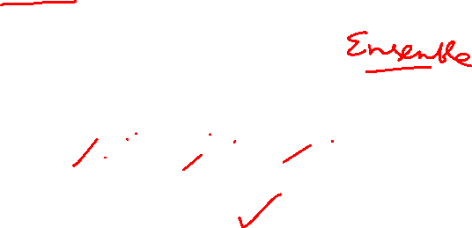
Naive Inception Module
Initial Idea: Parallel paths with different receptive fields
Next Layer
Filter Concatenation
1×1 Conv
3×3 Conv
5×5 Conv
3×3 MaxPool
Previous Layer
Problem: Computational cost explodes!
Example: Input 256 channels, output 256 channels each path Millions of operations
Deep Neural Network

Slide 30



Inception Module with Dimensionality
Solution: Add 1×1 convolutions before expensive operations
Concatenate: 28 × 28 × 256
64 + 128 + 32 + 32 = 256 channels
3×3, 128
5×5, 32
1×1, 16
1×1, 32
3×3 Pool
1×1, 64
Direct
1×1, 96
Reduce Reduce
Pool
Input: 28 × 28 × 256
Key Insight: 1×1 convs reduce channels before expensive 3×3 and 5×5 operations
Deep Neural Network

Slide 31
Inception Module: Computational Savings
Without 1×1 reduction (naive):
⁾ 3×3 conv: 28 × 28 × 256 × 128 × 3 × 3 ≈ 230M ops
⁾ 5×5 conv: 28 × 28 × 256 × 32 × 5 × 5 ≈ 160M ops
⁾ Total: ∼390M operations
With 1×1 reduction:
⁾ 1×1 reduce: 28 × 28 × 256 × 96 × 1 × 1 ≈ 19M ops
⁾ 3×3 conv: 28 × 28 × 96 × 128 × 3 × 3 ≈ 86M ops
⁾ 1×1 reduce: 28 × 28 × 256 × 16 × 1 × 1 ≈ 3M ops
⁾ 5×5 conv: 28 × 28 × 16 × 32 × 5 × 5 ≈ 10M ops
⁾ Total: ∼118M operations
Result: 3.3× reduction in computation! This is the bottleneck principle that became standard in deep networks.
Deep Neural Network

Slide 32

GoogLeNet Architecture
Overall Structure: 22 layers deep
Layer Type | Output Size | Details
Conv 7×7, stride 2 | 112 × 112 × 64
MaxPool 3×3, stride 2 | 56 × 56 × 64
Conv 3×3, stride 1 | 56 × 56 × 192
MaxPool 3×3, stride 2 | 28 × 28 × 192
Inception (3a) | 28 × 28 × 256 | 1st block
Inception (3b) | 28 × 28 × 480
MaxPool 3×3, stride 2 | 14 × 14 × 480
Inception (4a-4e) | 14 × 14 × 512 − 832 | 5 blocks
MaxPool 3×3, stride 2 | 7 × 7 × 832
Inception (5a-5b) | 7 × 7 × 832 − 1024 | 2 blocks
Global AvgPool | 1 × 1 × 1024 | NiN style
Dropout (40%) | 1 × 1 × 1024 | Regularization
FC + Softmax | 1000 classes | Output
Total: 9 Inception modules stacked with strategic pooling for downsampling
Deep Neural Network

Slide 33
Inception Module: Design Philosophy
Why does Inception work so well?
1
Multi-scale feature extraction
⁾ Different filters capture different scales
⁾ Network learns which scale is important per layer
Sparse connections
⁾ Not all inputs connected to all outputs
⁾ Mimics biological neural networks
Efficient computation
⁾ 1×1 bottlenecks reduce dimensions
⁾ Much fewer parameters than VGG
Increased network depth and width
⁾ Can go deeper without computational explosion
⁾ Multiple paths increase model capacity
2
3
4
Auxiliary Classifiers: GoogLeNet added intermediate classifiers during training to
combat vanishing gradients (removed at test time)
Deep Neural Network

Slide 34
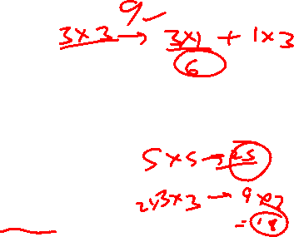
Inception Variants
Evolution of Inception Architecture:
Version | Year | Key Innovation
Inception v1 (GoogLeNet) | 2014 | Original inception module
Inception v2 | 2015 | Batch normalization
Inception v3 | 2015 | Factorized convolutions (3×3 3×1 + 1×3)
Inception v4 | 2016 | Combined with residual connections
Inception-ResNet | 2016 | Hybrid: Inception + skip connections
Factorization Example (v3):
Replace expensive 5×5 with two 3×3:
⁾ 5×5 conv: 25n² operations
⁾ Two 3×3 convs: 9n² + 9n² = 18n² operations
⁾ Savings: 28% fewer operations, same receptive field
Further: Replace 3×3 with 3×1 + 1×3:
⁾ 3×3 conv: 9n² operations
⁾ 3×1 + 1×3: 3n² + 3n² = 6n² operations
Deep Neural Network
127 / 153

Slide 35

ResNet (2015) - The Depth Problem
Surprising Discovery
Deeper networks performed worse than shallow networks on training set!
35
30
25
20
18-layer 56-layer
Training Error
15₀
40 60
Training Iterations
20
80
100
Problem: Not overfitting (training error is higher!), but optimization difficulty
Hypothesis: Deeper networks struggle to learn even identity mappings
Deep Neural Network

Slide 36



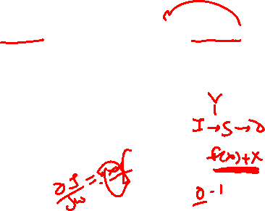
ResNet: The Residual Learning Idea
Key Insight: Instead of learning H(x) directly, learn the residual F (x) = H(x) — x
Residual Block:
Traditional Block:
Learn target mapping directly:
H(x) = layers(x)
Learn the difference (residual):
H(x) = F (x) + x
Why easier? If identity is optimal, network just needs to learn F (x) = 0 (push weights to zero), which is easier than learning identity explicitly!
H(x)
H(x)
+
Conv
F (x)
Conv
Conv
identity
Conv
x
x
x
Deep Neural Network

Slide 37


Basic Residual Block
y
Building Block for ResNet-18 and ResNet-34:
Key Components:
⁾ Two 3×3 convolutions
⁾ Batch normalization after each conv
⁾ ReLU activation (one in middle, one at end)
⁾ Identity skip connection (red dashed)
ReLU
+
y = F (x) + x
Batch Norm
3×3 Conv, 64
ReLU
identity
Batch Norm
F (x)
3×3 Conv, 64
x
Deep Neural Network
130 / 153

Slide 38
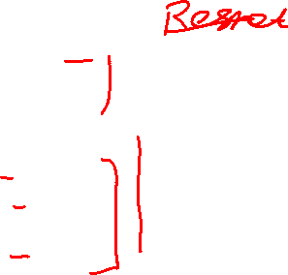
Bottleneck Residual Block
y
256 ch
Used in ResNet-50, ResNet-101, ResNet-152 for efficiency:
Bottleneck Strategy:
1×1 reduce 3×3 process 1×1 expand
Parameter savings:
256×64+64×64×9+64×256 =
70K vs. 256 × 256 × 9 = 590K
(8.4× reduction!)
ReLU
+
BN
Expand
1×1 Conv, 256
BN + ReLU
Process
3×3 Conv, 64
BN + ReLU
Reduce
1×1 Conv, 64
x
256 ch
Deep Neural Network

Slide 39


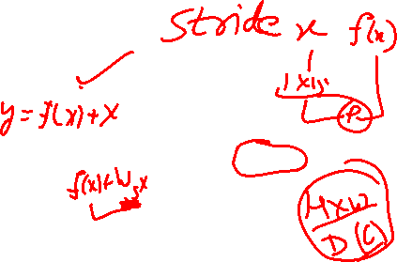
ResNet: Handling Dimension Mismatch
Problem: What if input and output dimensions don’t match?
Solution: Projection Shortcut When dimensions change (spatial or channel):
Projection:
⁾ 1×1 convolution with stride=2 (downsample spatially)
⁾ Adjusts number of channels
⁾ Enables skip connection even when dimensions change
^{y} 28 × 28 × 128
+
Conv + BN
Match dimensions
1×1 Conv
Conv + BN
stride=2
x
56 × 56 × 64
Deep Neural Network

Slide 40
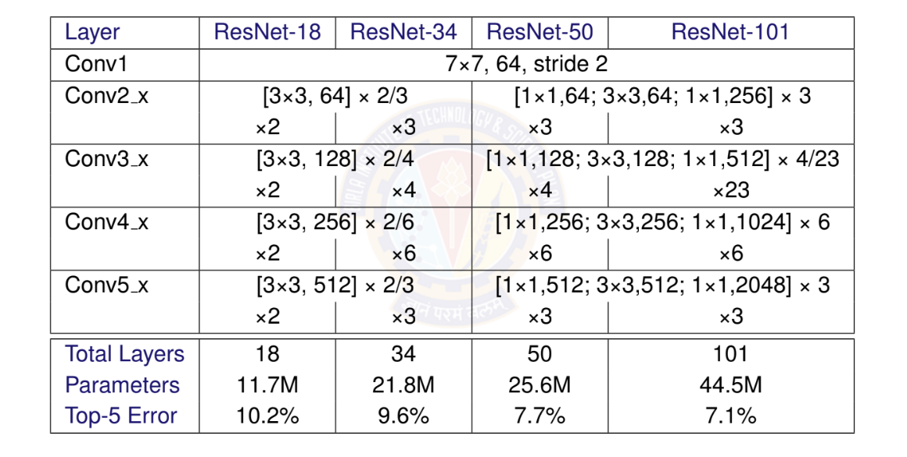

ResNet Architecture Family
Deep Neural Network

Slide 41
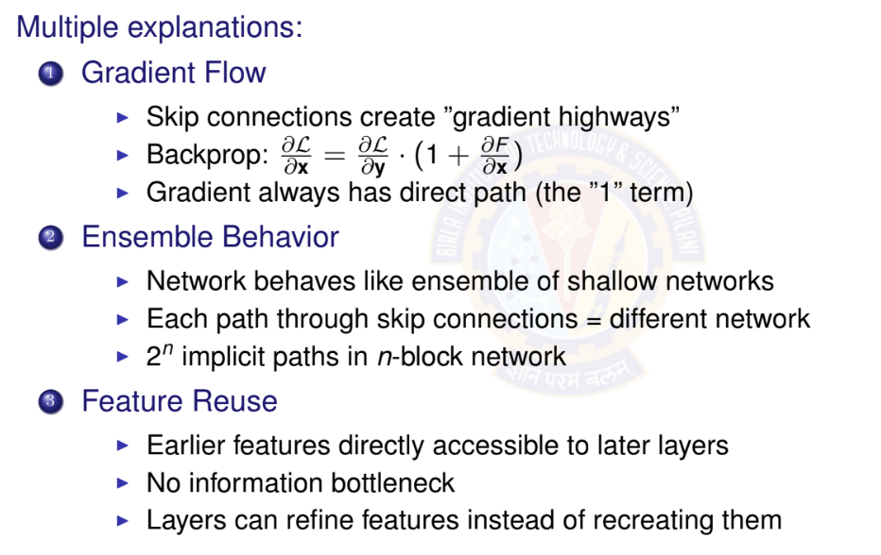

Why Do Residual Connections Work?
Deep Neural Network

Slide 42

ResNet: Key Takeaways
Revolutionary Impact ResNet enabled training of networks with 100+ layers, winning ImageNet 2015 with 3.6% error (superhuman performance on ImageNet!)
Core Contributions:
Residual Learning: Learn F (x) = H(x) — x instead of H(x)
Skip Connections: Identity shortcuts for gradient flow
Very Deep Networks: 50-152 layers trainable (even 1000+ demonstrated) Bottleneck Design: Efficient deep networks using 1×1 convolutions
1
2
3
4
Impact on Field:
Skip connections now standard in almost all architectures DenseNet, U-Net, EfficientNet all use residual-style connections Transfer learning: ResNet features widely used as backbones
Enabled modern very deep networks (Transformers also use residuals!)
Deep Neural Network

Slide 43

Table of Contents
Computer Vision Tasks
Image Basics and Image Classification Challenges
Introduction to Convolutional Networks
CNN Components
CNN Architecture Design
Popular CNN Architectures
Transfer Learning
CNN Applications
Implementation Considerations
Summary
1
2
3
4
5
6
7
8
9
10
Deep Neural Network

Slide 44
Transfer Learning Concept
Definition
Using a pre-trained model on one task as the starting point for a related task
Why Transfer Learning?
Limited Data: Small datasets benefit from pre-trained features Computational Efficiency: Avoid training from scratch
Better Performance: Often achieves better results Feature Reusability: Low-level features are transferable
Common Scenario
Source Task: ImageNet classification (1.2M images, 1000 classes) Target Task: Your specific classification problem
Assumption: Similar low-level visual features
Deep Neural Network

Slide 45
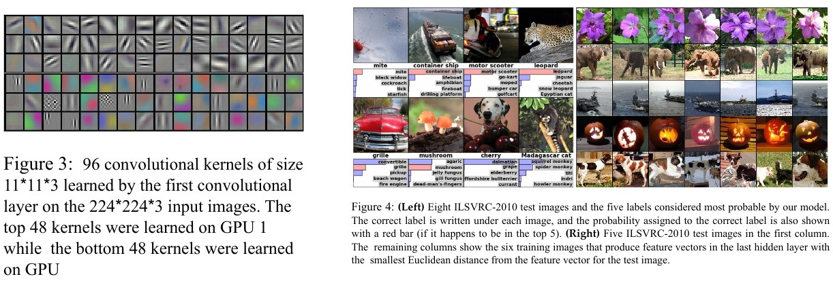
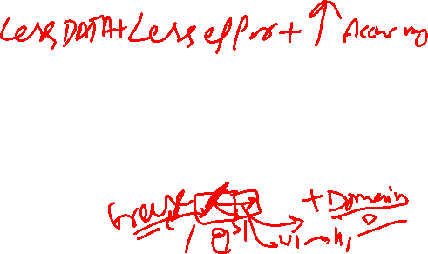
ImageNet Data
Deep Neural Network

Slide 46
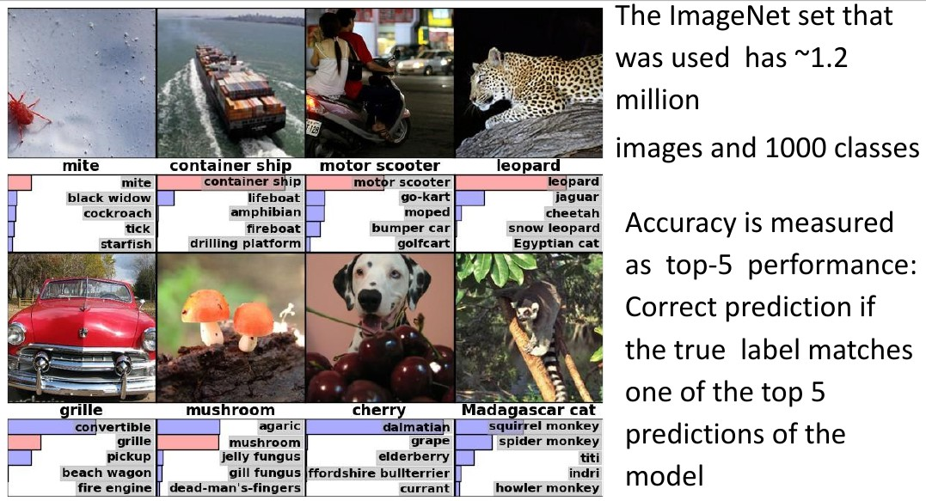

ImageNet Data
Deep Neural Network

Slide 47
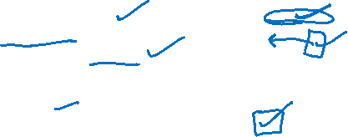
Transfer Learning Strategies
Strategy 1: Feature Extraction Freeze pre-trained layers
Train only classifier (final layer)
Use when: Small dataset, similar to pre-trained data Strategy 2: Fine-tuning
Initialize with pre-trained weights
Train entire network with low learning rate
Use when: Medium dataset, somewhat similar data Strategy 3: Selective Fine-tuning
Freeze early layers, fine-tune later layers
Balance between feature extraction and fine-tuning Use when: Medium dataset, different but related data
Deep Neural Network

Slide 48

Transfer Learning Guidelines
Data Similarity
Feature Extraction Freeze conv layers Train classifier only | Fine-tuning Small learning rate All layers
Train from scratch or selective Fine-tuning | Train from scratch Large dataset Different domain
Similar
Different
Dataset Size
Small
Large
Deep Neural Network

Slide 49

Table of Contents
Computer Vision Tasks
Image Basics and Image Classification Challenges
Introduction to Convolutional Networks
CNN Components
CNN Architecture Design
Popular CNN Architectures
Transfer Learning
CNN Applications
Implementation Considerations
Summary
1
2
3
4
5
6
7
8
9
10
Deep Neural Network

Slide 50
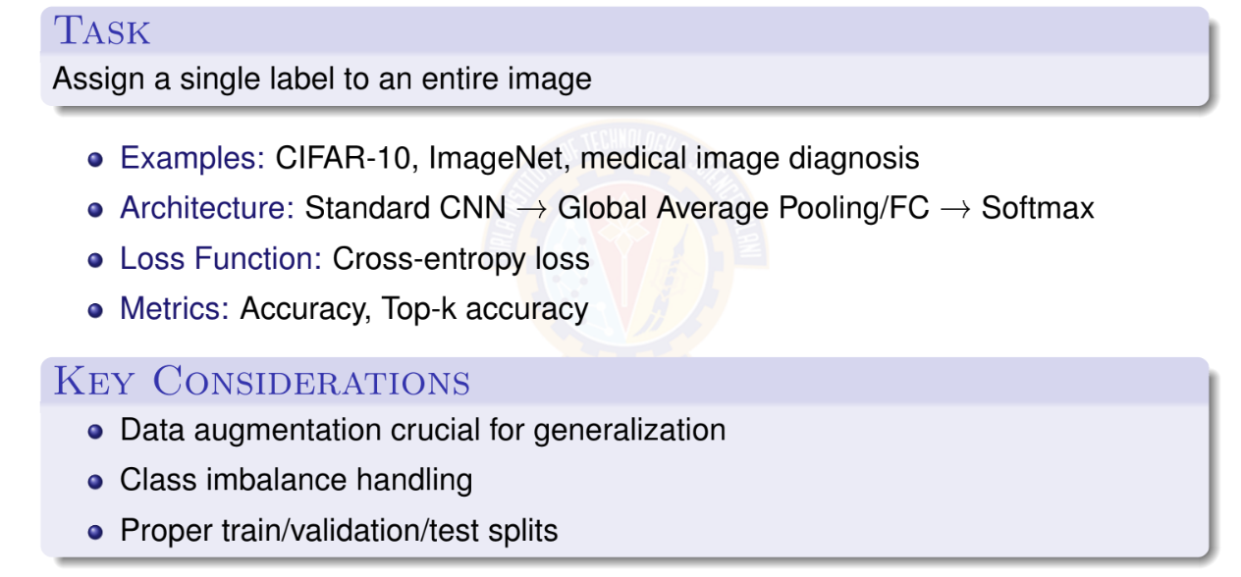
Image Classification
Deep Neural Network

Slide 51
Object Detection
Task
Locate and classify multiple objects in an image
Output: Bounding boxes + class labels Approaches:
⁾ Two-stage: R-CNN, Fast R-CNN, Faster R-CNN
⁾ One-stage: YOLO, SSD
Challenges: Multiple scales, varying object sizes, real-time requirements
Deep Neural Network

Slide 52
Semantic Segmentation
Task
Classify every pixel in the image
Output: Dense pixel-wise predictions Architectures:
⁾ FCN: Fully Convolutional Networks
⁾ U-Net: Encoder-decoder with skip connections
⁾ DeepLab: Atrous convolutions, multi-scale features
Applications: Medical imaging, autonomous driving, satellite imagery
Deep Neural Network

Slide 53
Other CNN Applications
Computer Vision Tasks
Face Recognition: Identity verification, face detection Style Transfer: Artistic style application
Image Generation: GANs, VAEs
Super-Resolution: Enhance image quality
Beyond Computer Vision
Natural Language Processing: Text classification, sentiment analysis Audio Processing: Speech recognition, music analysis
Time Series: 1D convolutions for sequential data Graph Neural Networks: Graph convolutions
Deep Neural Network

Slide 54

Table of Contents
Computer Vision Tasks
Image Basics and Image Classification Challenges
Introduction to Convolutional Networks
CNN Components
CNN Architecture Design
Popular CNN Architectures
Transfer Learning
CNN Applications
Implementation Considerations
Summary
1
2
3
4
5
6
7
8
9
10
Deep Neural Network

Slide 55
Practical Implementation Tips
Data Preprocessing
⁾ Normalize pixel values (0-1 or standardize)
⁾ Data augmentation: rotation, flipping, cropping, color jittering
⁾ Proper train/validation/test splits
Architecture Design
⁾ Start simple, add complexity gradually
⁾ Use batch normalization for faster training
⁾ Apply dropout for regularization
⁾ Monitor validation performance
Training Strategy
⁾ Use appropriate learning rate scheduling
⁾ Early stopping to prevent overfitting
⁾ Gradient clipping for stability
⁾ Use pre-trained models when possible
Deep Neural Network

Slide 56
Common Pitfalls and Solutions
Overfitting
⁾ Symptoms: High training accuracy, poor validation accuracy
⁾ Solutions: More data, data augmentation, dropout, L2 regularization
Underfitting
⁾ Symptoms: Poor performance on both training and validation
⁾ Solutions: textcolorBitsRedr model, more training time, lower regularization
Vanishing/Exploding Gradients
⁾ Solutions: Proper initialization, batch normalization, residual connections
Computational Efficiency
⁾ Use appropriate batch sizes
⁾ Mixed precision training
⁾ Model compression techniques
Deep Neural Network

Slide 57

Table of Contents
Computer Vision Tasks
Image Basics and Image Classification Challenges
Introduction to Convolutional Networks
CNN Components
CNN Architecture Design
Popular CNN Architectures
Transfer Learning
CNN Applications
Implementation Considerations
Summary
1
2
3
4
5
6
7
8
9
10
Deep Neural Network

Slide 58
Key Takeaways
Core Concepts
CNNs exploit spatial structure through local connectivity and parameter sharing
Convolution, pooling, and non-linear activations are building blocks Hierarchical feature learning: edges shapes objects
Architecture Evolution
LeNet AlexNet → VGG→GoogLeNet→ResNet→Modern architectures
Key innovations: ReLU, dropout, batch normalization, residual connections Trend: Deeper networks with better optimization techniques
Deep Neural Network

Slide 59
Practical Guidelines
Start with transfer learning when possible
Data augmentation is crucial for generalization Monitor both training and validation metrics
Use appropriate regularization techniques
Implement a simple CNN from scratch
Experiment with different architectures on CIFAR-10 Try transfer learning with pre-trained models Explore data augmentation techniques
Deep Neural Network

Slide 60

References
Zhang, A., Lipton, Z. C., Li, M., & Smola, A. J. (2023). Dive into deep learning. Cambridge University Press. Chapters 6 and 7.
Goodfellow, I., Bengio, Y., Courville, A. (2016). Deep Learning. MIT Press. LeCun, Y., Bottou, L., Bengio, Y., & Haffner, P. (1998). Gradient-based learning applied to document recognition. Proceedings of the IEEE, 86(11), 2278-2324.
Krizhevsky, A., Sutskever, I., & Hinton, G. E. (2012). ImageNet classification with deep convolutional neural networks. Advances in NIPS.
Simonyan, K., & Zisserman, A. (2014). Very deep convolutional networks for large-scale image recognition. arXiv preprint arXiv:1409.1556.
Szegedy, C., et al. (2015). Going deeper with convolutions. Proceedings of the IEEE CVPR.
He, K., Zhang, X., Ren, S., & Sun, J. (2016). Deep residual learning for image recognition. Proceedings of the IEEE CVPR.
Deep Neural Network

